Slide 1

Roadmap
Part I: Knowledge Graph Reasoning: Basic Concepts and Techniques
Part II: Recent Advance #1: Neural Reasoning for Natural Language Queries
Part III: Recent Advance #2: Neural Reasoning for Logical Queries
Part IV: Recent Advance #3: Neural Reasoning Beyond Entities and Relations
Part V: Recent Advance #4: LLM+KGR
Part VI: Open Challenges and Future Directions
Notes:
Today’s tutorial contains 4 parts.
At the beginning, I would like to give some background regarding the knowledge graph reasoning as well as the unique challenges behind this problem setting.
In part 1, we will introduce the details of general knowledge graph reasoning. and in part 2, we will introduce query specific knowledge graph reasoning. And finally, we will discuss the future trends for knowledge graph reasoning.

Slide 2
Large Language Models
Language model: a probability distribution over strings of text
Sally fed my cat with meat: P(Sally, feed, my, cat, with, meat) = 0.03,
My cat fed Sally with meat: P(My, cat, fed, Sally, with, meat) = 0.005,
Fed cat meat my my with: P(Fed, cat, meat, my, my, with) = 0.0001
Large language models (LLM): large, general-purpose language models can be pre-trained and then fine-tuned for specific purposes [2]
Examples: GPT-3.5, GPT-4, Llama2 and Llama3
[1] J. Huang. https://teapot123.github.io/files/CSE561A_slides/Lecture_1.pdf
[2] Google Cloud Tech. Introduction to Large Language Models. (2023).

Slide 3
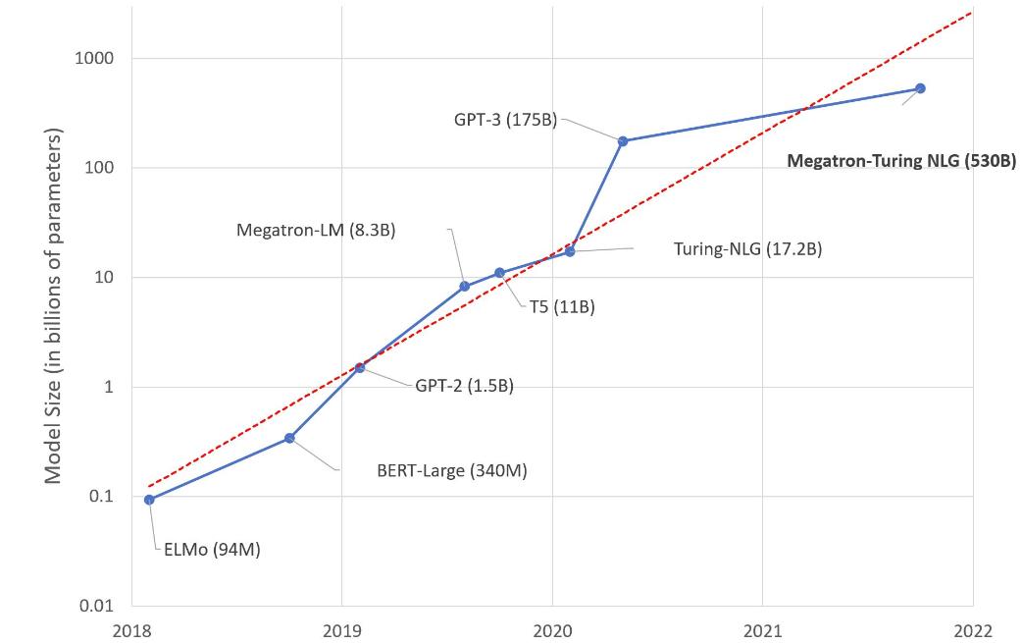
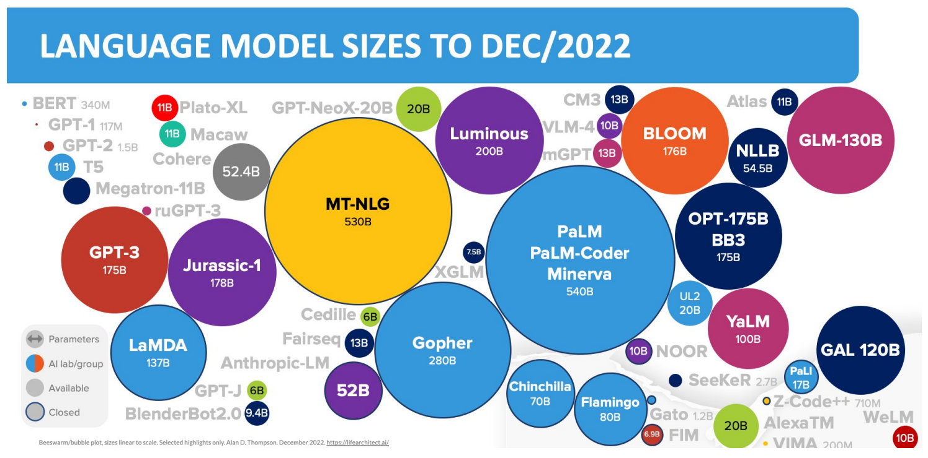
Model Size of LLMs
Size: from millions of parameters to billions of parameters

Slide 4
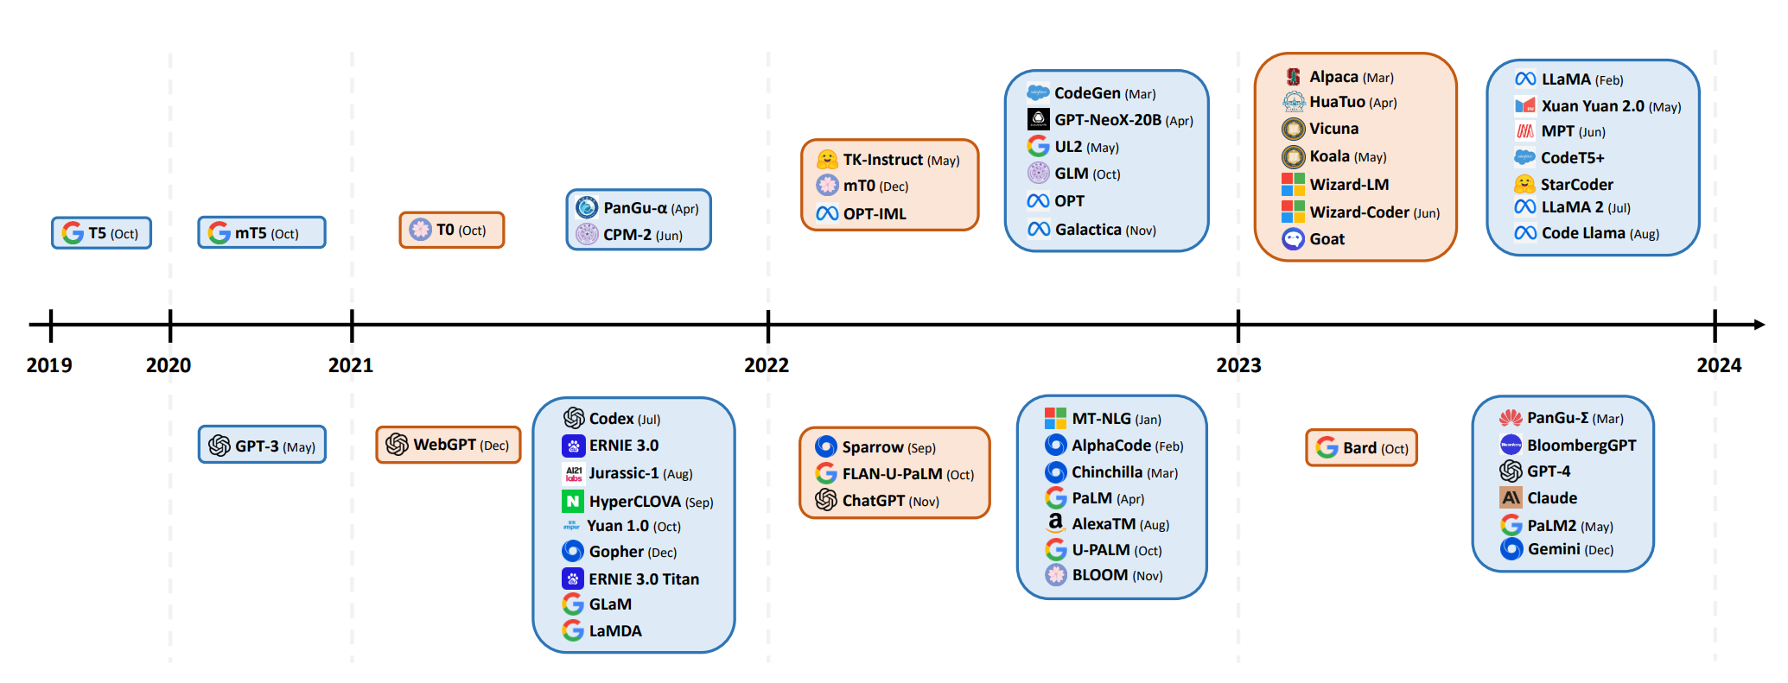
Large Language Models in Recent Literature
Progression and improvement of large language models
[1] H. Naveeda, A. Khana, S. Qiub, M. Saqib. 2024. A Comprehensive Overview of Large Language Models (arVix 24).

Slide 5
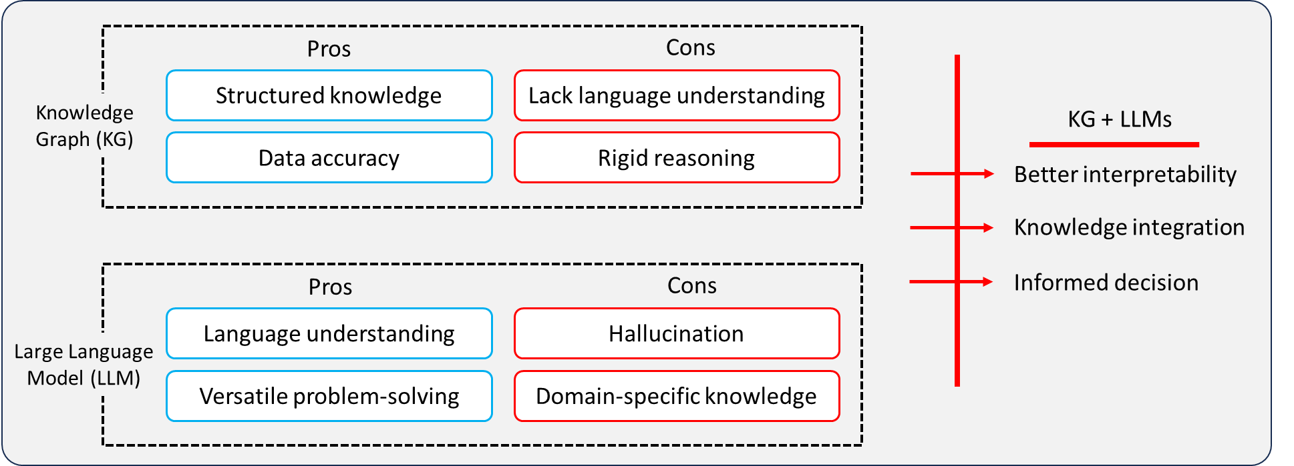
Knowledge Graphs VS LLMs
Knowledge graph
Pros: accurate structural knowledge, interpretable, …
Cons: incomplete, lack language understanding
LLMs
Pros: general knowledge, good at language understand,…
Cons: hallucination, lack interpretation, lacking new knowledge, …

Slide 6
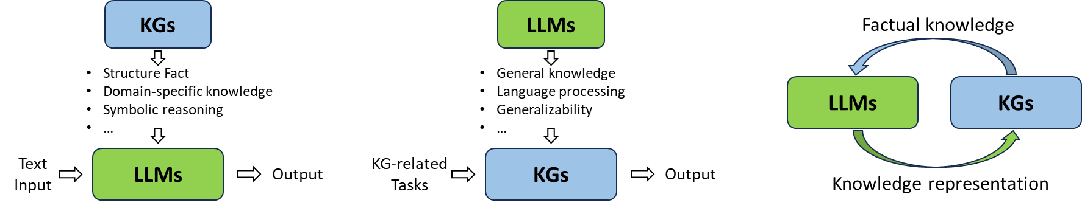
Combining Knowledge Graph with LLMs
Categorization
Knowledge graph enhance LLMs
LLMs enhance knowledge graph reasoning
Integrating knowledge graph reasoning with LLMs in a mutually beneficial way
KG-enhanced LLMs
LLMs-augmented KGs
Synergized LLMs + KGs
[1] S. Pan, L. Luo,Y. Wang, C Chen. 2024. Unifying Large Language Models and Knowledge Graphs: A Roadmap (TKDE 24).

Slide 7
Combining Knowledge Graph with LLMs
Categorization
Knowledge graph enhance LLMs
LLMs enhance knowledge graph reasoning
Integrating knowledge graph reasoning with LLMs in a mutually beneficial way
KG-enhanced LLMs
LLMs-augmented KGs
Synergized LLMs + KGs
[1] S. Pan, L. Luo,Y. Wang, C Chen. 2024. Unifying Large Language Models and Knowledge Graphs: A Roadmap (TKDE 24).

Slide 8
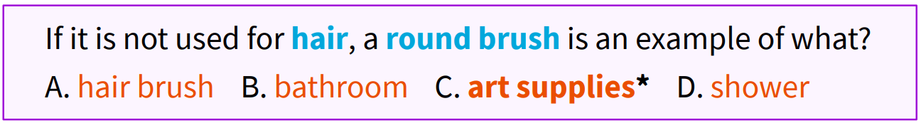
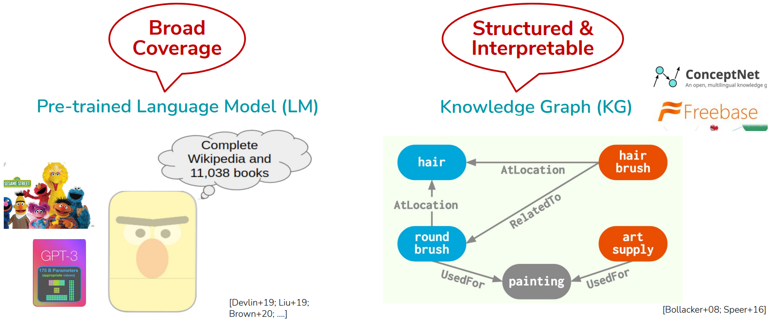
QA-GNN: Reasoning with Language Models and Knowledge Graphs for Question Answering
Goal: answer multi-choice question
Philosophy: the system needs to access a lot of knowledge and reason about it
VS
[1] M. Yasunaga, H. Ren, A. Bosselut, P. Liang, J. Leskovec. 2021. QA-GNN: Reasoning with Language Models and Knowledge Graphs for Question Answering (NAACL 21).

Slide 9
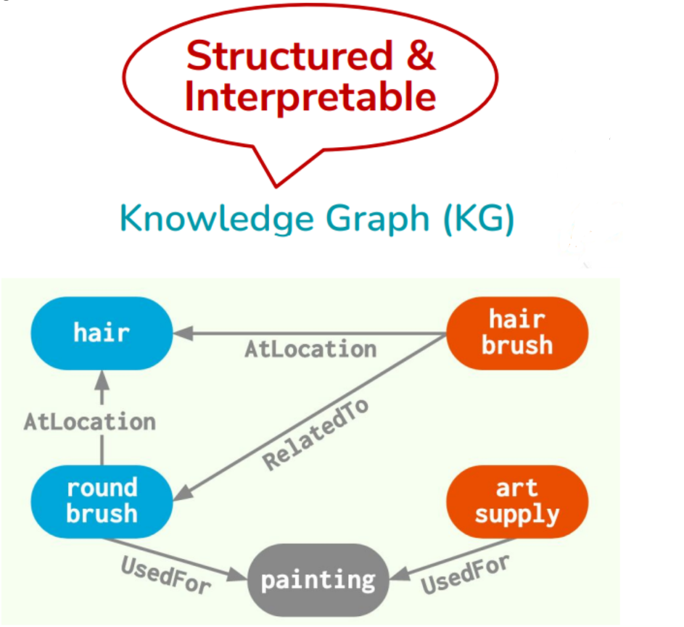
QA-GNN: Reasoning with Language Models and Knowledge Graphs for Question Answering
Existing problem:
Language models do not work well for interpretable or logical reasoning; they lack interpretation
KG is incomplete and noisy
Challenges
how to identify the relevant information in the knowledge graph
how to jointly reason over the text and the knowledge graph
[1] M. Yasunaga, H. Ren, A. Bosselut, P. Liang, J. Leskovec. 2021. QA-GNN: Reasoning with Language Models and Knowledge Graphs for Question Answering (NAACL 21).
Notes:
Pretrained language models have shown great performance in many QA tasks. But at the same time, they may not work well for interpretable or logical reasoning.
On the other hand, KGs are more explicitly represented, and contain structure reasoning. But the knowledge graph is incomplete and noisy.
Thus, in order to leverage both sources of knowledge to enhance question answering performance,
there are two challenges: how to identify the relevant information in the knowledge graph, and how to jointly reason over the text and the knowledge graph.

Slide 10
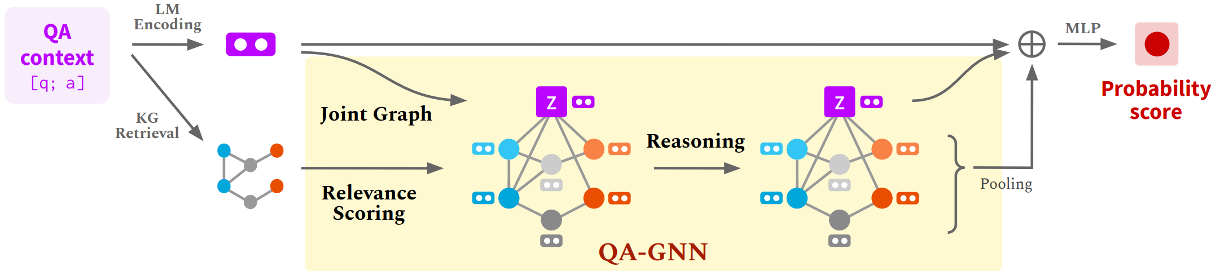
QA-GNN: Main Steps
Idea:
Language-conditioned KG node relevance scoring
Joint Reasoning:
Connect text and KG to form a joint graph (working graph)
Mutually update their representations via Graph Neural Network (GNN)
[1] M. Yasunaga, H. Ren, A. Bosselut, P. Liang, J. Leskovec. 2021. QA-GNN: Reasoning with Language Models and Knowledge Graphs for Question Answering (NAACL 21).
Notes:
In this work, the authors present QA-GNN, a hybrid model, which combines LLM and knowledge graph to solve this problem.
Here is the overview of QA-GNN.
First of all, given a QA context, it will use the language model to encode question to a vector presentation, then use stand method to retrieve a knowledge graph subset, like linking entities and get their neighbors, and reasoning according to the subgraph.

Slide 11
QA-GNN: Main Steps
Idea:
Language-conditioned KG node relevance scoring
Joint Reasoning:
Connect text and KG to form a joint graph (working graph)
Mutually update their representations via Graph Neural Network (GNN)
[1] M. Yasunaga, H. Ren, A. Bosselut, P. Liang, J. Leskovec. 2021. QA-GNN: Reasoning with Language Models and Knowledge Graphs for Question Answering (NAACL 21).
Notes:
Then QA-GNN is based on two core ideas. First, in order to better identify which knowledge graph nodes relevant to current question, they propose language condition KG nodes scoring where they use a pretrained language model to compute the probability of each kg entity condition on the current question.

Slide 12
QA-GNN: Main Steps
Idea:
Language-conditioned KG node relevance scoring
Joint Reasoning with language models:
Connect text and KG to form a joint graph (working graph)
Mutually update their representations via Graph Neural Network (GNN)
[1] M. Yasunaga, H. Ren, A. Bosselut, P. Liang, J. Leskovec. 2021. QA-GNN: Reasoning with Language Models and Knowledge Graphs for Question Answering (NAACL 21).
Notes:
to jointly reason with language models, they connect the question text and kg to form a joint graph, which we call working graph, they mutually update their representations, through graph neural networks.

Slide 13
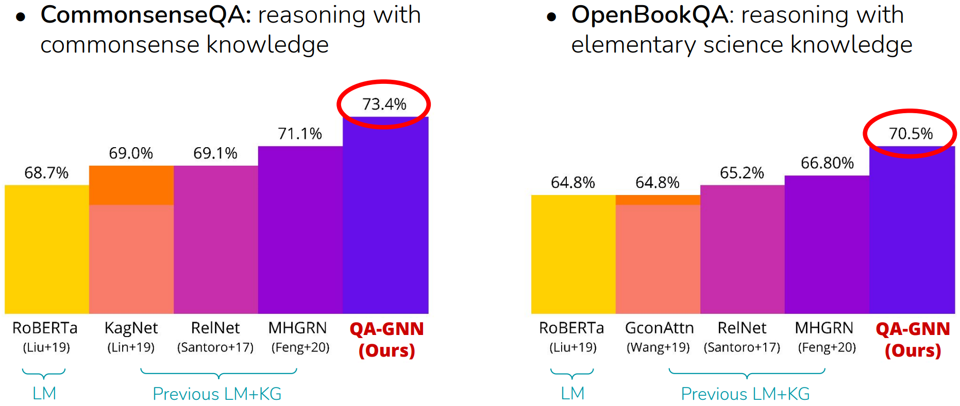
QA-GNN: Experiment Results
Improved performance on two QA tasks
[1] M. Yasunaga, H. Ren, A. Bosselut, P. Liang, J. Leskovec. 2021. QA-GNN: Reasoning with Language Models and Knowledge Graphs for Question Answering (NAACL 21).

Slide 14
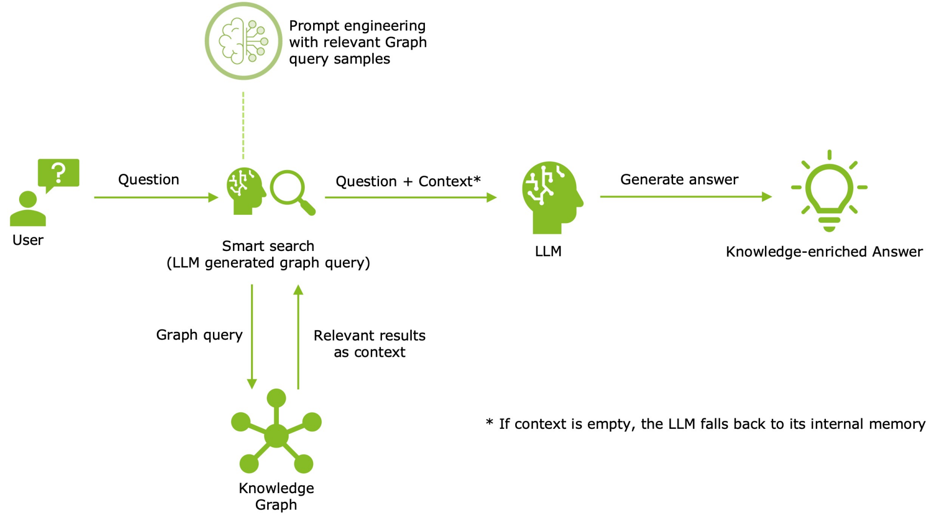
Retrieval-Augmented Generation (RAG) with Knowledge Graph
Observation:
When the size of the model becomes large, retrain or finetune the model will be very time consuming
More information related to RAG can be found in the tutorial titled 'Large Language Models for Graphs: Progresses and Directions,' as well as in many others.

Slide 15
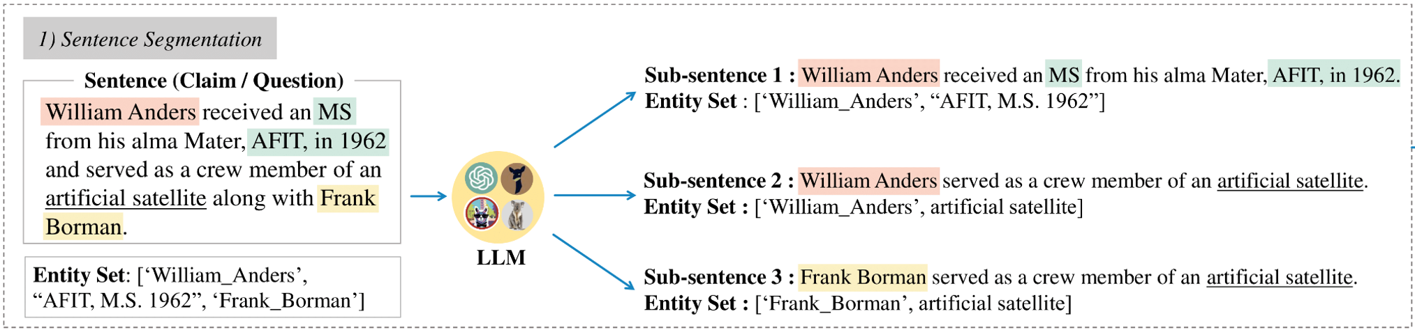
KG-GPT: A General Framework for Reasoning on KGs Using LLMs
Goal: utilize language models and knowledge graphs to answer a more complex natural language questions
Idea:
[1] J. Kim, Y. Kwon, Y. Jo, E. Choi. 2023. KG-GPT: A General Framework for Reasoning on Knowledge Graphs Using Large Language Models (EMNLP 23).
Notes:
Now, we have introduced how to use knowledge graphs to help train language models to better answer different types of questions. However, when the size of the model becomes large, retrain or finetune the model will be very time consuming. An alternative way is to use prompt engineering or in-context learning.
This approach allows for more targeted adjustments without the need for extensive retraining, making it particularly advantageous for large-scale models.
In KG-GPT, the authors propose a method to utilize language models and knowledge graphs to answer a more complex natural language questions.
The idea is that a sentence of question, it uses llms to decompose the original sentence to several sub-sentences and find answers for each sub-sentence. And finally, find the answer for the whole sentence.

Slide 16
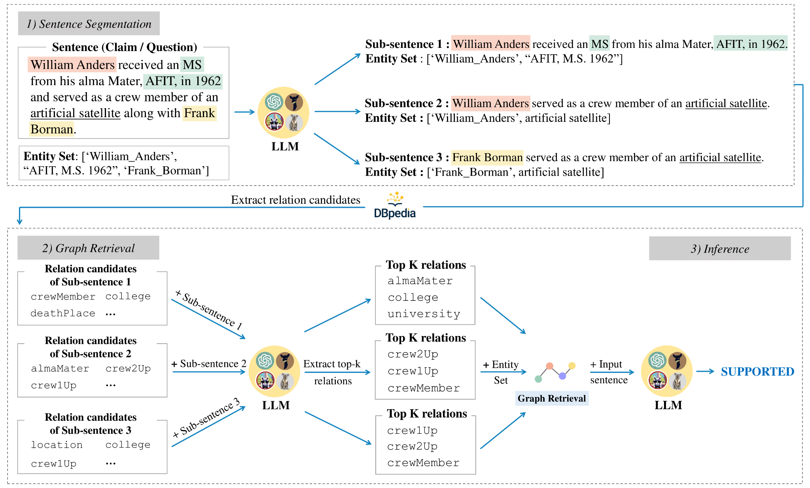
KG-GPT: A General Framework for Reasoning on KGs Using LLMs
Sentence Segmentation
Graph Retrieval
Extract relation candidates from KG
Inference
Graph to prompt
[1] J. Kim, Y. Kwon, Y. Jo, E. Choi. 2023. KG-GPT: A General Framework for Reasoning on Knowledge Graphs Using Large Language Models (EMNLP 23).
Notes:
More specifically, KG-GPT consists of three steps: 1) Sentence (Claim / Question) Segmentation, 2) Graph Retrieval, and 3) Inference. During Sentence Segmentation, a sentence is partitioned into discrete sub-sentences, each aligned with a single triple (i.e. [head, relation, tail]).
The subsequent step, namely Graph Retrieval, retrieves a potential pool of relations that could bridge the entities identified within the sub-sentences. Then, a candidate pool of evidence graphs (i.e. sub-KG) is obtained using the retrieved relations and the entity set.
In the final step, the obtained graphs are used to derive a logical conclusion, such as validating a given claim or answering a given question.

Slide 17
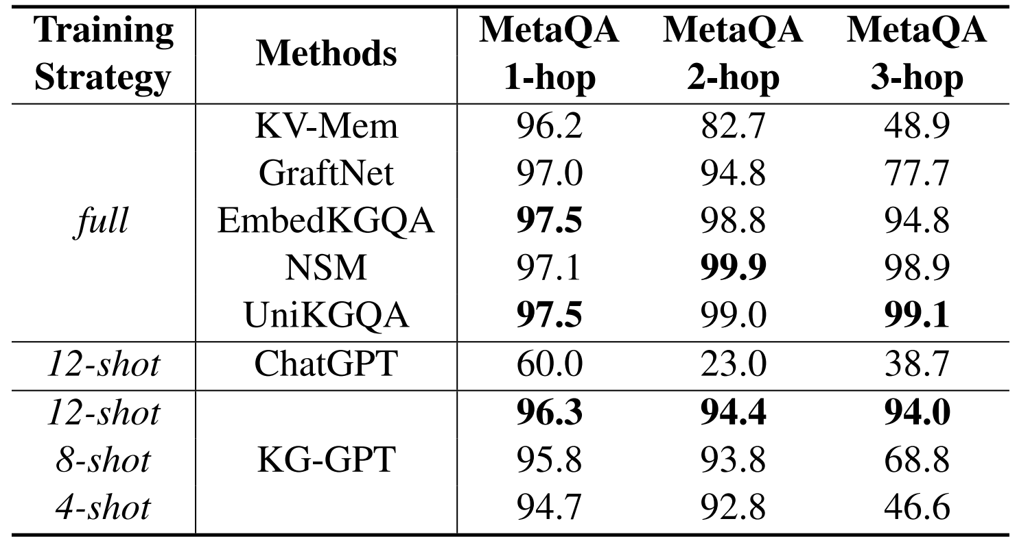
KG-GPT: A General Framework for Reasoning on KGs Using LLMs
Observation: combining KG with LLMs can significantly improve accuracy
Dataset: MetaQA
[1] J. Kim, Y. Kwon, Y. Jo, E. Choi. 2023. KG-GPT: A General Framework for Reasoning on Knowledge Graphs Using Large Language Models (EMNLP 23).
Notes:
For the experiment, we can find that it significantly outperforms large language models, like ChatGPT with more than 40% in average. While it can achieve the comparable performance compared to the state-of-the-art embedding models EmbedKGQA when the knowledge graph is full.

Slide 18
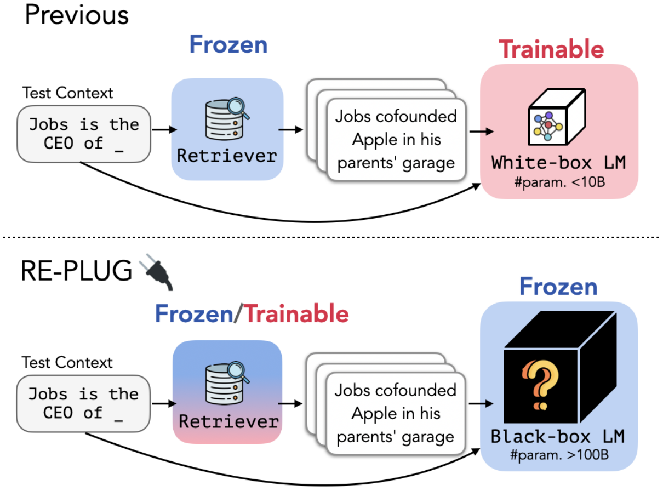
REPLUG: Retrieval-Augmented Black-Box Language Models
Previous methods:
Enhance a language model with retrieval by updating the LM’s parameters
REPLUG:
Treats the language model as a black box
Augments it with a frozen or tunable retriever
Makes REPLUG applicable to large LMs, which are often served via APIs.

Slide 19
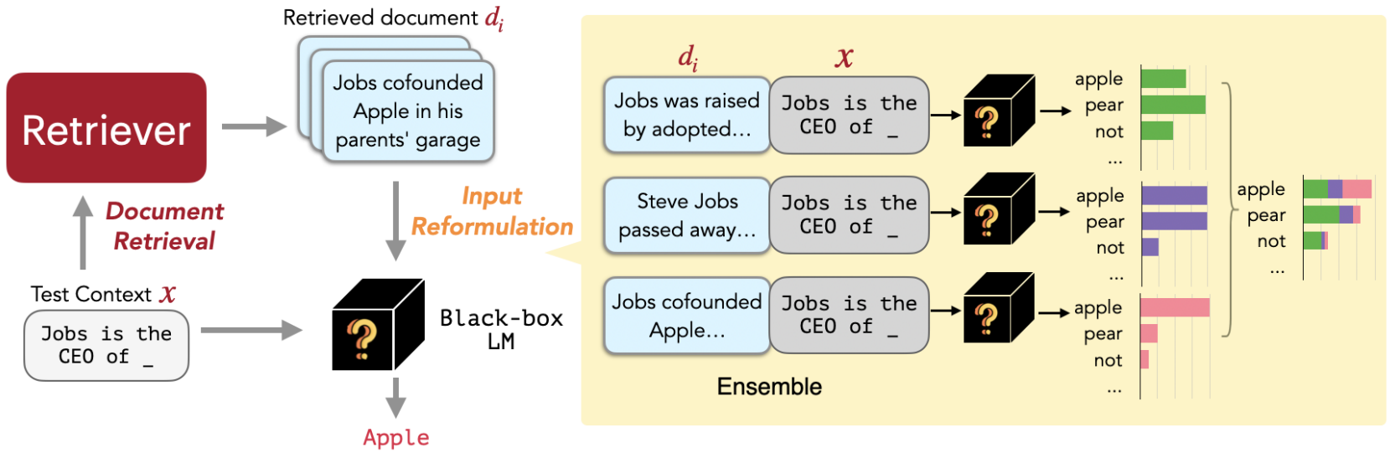
REPLUG
First retrieves a small set of relevant documents from an external corpus
Then pass the concatenation of each retrieved document with the input context through the LM in parallel, and ensemble the predicted probabilities

Slide 20
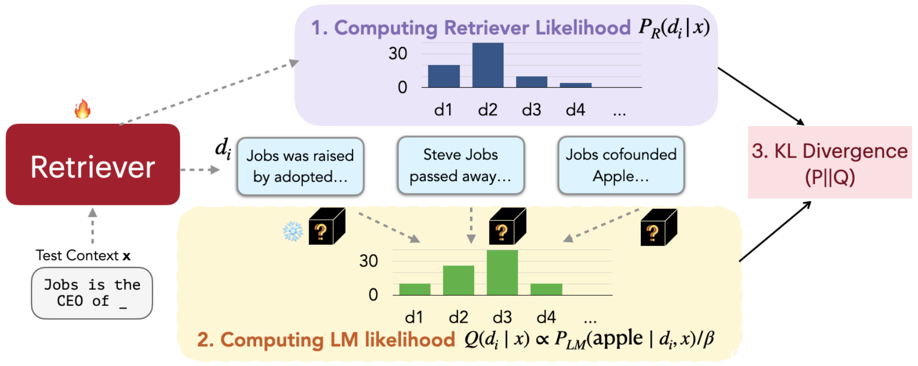
REPLUG LSR
(1) Using retriever to computing the retrieval likelihood
(2) Computing LM likelihood
(3) Updating the retrieval model parameters by minimizing the KL divergence between the retrieval likelihood and the LM’s score distribution

Slide 21
From Local to Global: A Graph RAG Approach to Query-Focused Summarization
Existing problem
Fail on global questions such as “what are the main themes in the dataset?”
GraphRAG
Indexing process aimed at creating LLM Memory Representation on private data
Generating Knowledge Graphs
Dividing entities to different communities

Slide 22


Preprocessing Pipeline – Graph Enabled RAG
Private Dataset
- Too large for context window
- “semantic Search” works, but we know nothing of the dataset!
Baseline RAG
Text Chunks
Semantic search DB

Slide 23
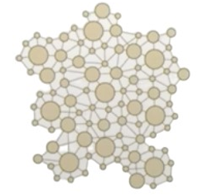
Preprocessing Pipeline – Graph Enabled RAG
Graph Induction
POK leader Sylvia Marek took the stage with Lucio Jakab, founder of Save Our Wildlands
GraphRAG
Text Chunks
Private Dataset
GraphRAG
- Too large for context window
- “semantic Search” works, but we know nothing of the dataset!
Baseline RAG
Text Chunks
Semantic search DB

Slide 24
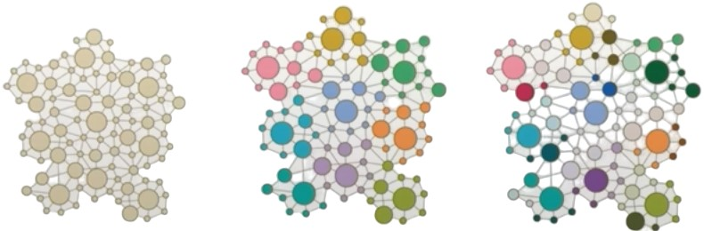
Preprocessing Pipeline – Graph Enabled RAG
Graph Induction
POK leader Sylvia Marek took the stage with Lucio Jakab, founder of Save Our Wildlands
GraphRAG
Text Chunks
Private Dataset
GraphRAG
Graph ML
-Topic Detection
-Representation Learning
Hierarchy Extraction
Graph Embedding
Entity Summarization
Community Summarization
- Too large for context window
- “semantic Search” works, but we know nothing of the dataset!
GraphRAG
Baseline RAG
Text Chunks
GraphRAG
Entity Content
Semantic search DB
Level 0
Community
Level 1
Community
Level 2
Community

Slide 25

Preprocessing Pipeline – Graph Enabled RAG
Graph Induction
Database Question Generator
Summarized Q&A
Etc.
POK leader Sylvia Marek took the stage with Lucio Jakab, founder of Save Our Wildlands
GraphRAG
Text Chunks
Private Dataset
GraphRAG
Graph ML
-Topic Detection
-Representation Learning
Hierarchy Extraction
Graph Embedding
Entity Summarization
Community Summarization
- Too large for context window
- “semantic Search” works, but we know nothing of the dataset!
GraphRAG
GraphRAG
Baseline RAG
Text Chunks
GraphRAG
Entity Content
Semantic search DB
Level 0
Community
Level 1
Community
Level 2
Community

Slide 26
Combining Knowledge Graph with LLMs
Categorization
LLMs enhance knowledge graph reasoning
Knowledge graph reasoning enhance LLMs
Integrating knowledge graph reasoning with LLMs in a mutually beneficial way
KG-enhanced LLMs
LLMs-augmented KGs
Synergized LLMs + KGs
[1] S. Pan, L. Luo,Y. Wang, C Chen. 2024. Unifying Large Language Models and Knowledge Graphs: A Roadmap (TKDE 24).

Slide 27
Think-on-Graph: Deep and Responsible Reasoning of Large Language Model on Knowledge Graph
Traditional methods
Retrieve information from KGs
Augment the prompt and feed it into LLMs
LLMs do not participate in the graph reasoning process directly
Existing problem
Suffer from knowledge graph incompleteness
[1] J. Sun, C. Xu, L. Tang, S. Wang, C. Lin. 2024. Think-on-Graph: Deep and Responsible Reasoning of Large Language Model on Knowledge Graph (ICLR 24).
Notes:
Traditional methods retrieve information from KGs, augment the prompt accordingly, and feed the increased prompt into LLMs.
In this paradigm, LLM plays the role of translator which transfers input questions to machine-understandable command for KG searching and reasoning, but it does not participate in the graph reasoning process directly.
Its success depends heavily on the completeness and high quality of KG, which means that if the knowledge graph contains many missing edges, the answer won’t be good.
So, recently, some people tried to explore how to mitigate the knowledge graph incompleteness problem by treating the LLM as an agent to travel KGs and perform reasoning based on paths.

Slide 28
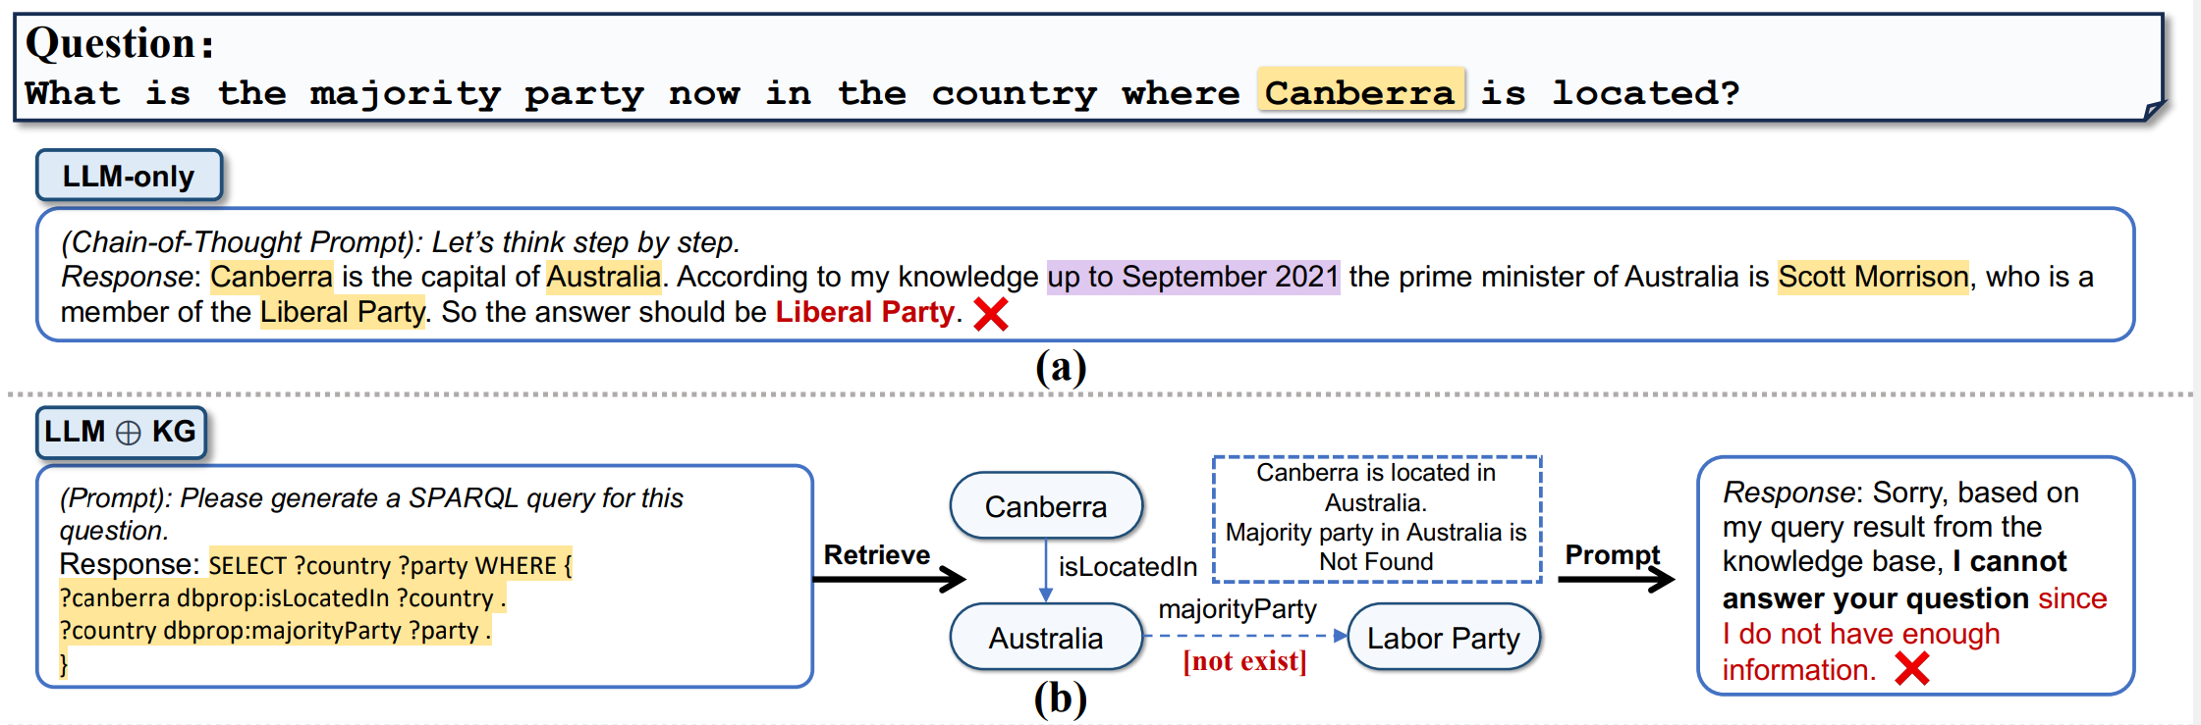
Think-on-Graph: Deep and Responsible Reasoning of Large Language Model on Knowledge Graph
Goal: treats the LLM as an agent to travel KGs and perform reasoning based on paths
Method1
Method2
[1] J. Sun, C. Xu, L. Tang, S. Wang, C. Lin. 2024. Think-on-Graph: Deep and Responsible Reasoning of Large Language Model on Knowledge Graph (ICLR 24).
Notes:
For example, given question “What is the major party now in the country where Canberra is located?”. Directly using LLM to answer the question will lead to some wrong answers.
While existing LLMs plus KG methods will transform the natural language question to a symbolic SPARQL query and retrieve information from KGs, augment the prompt accordingly, and feed the increased prompt into LLMs. However, its success depends heavily on the completeness and high quality of KG.
For example, although LLM successfully identified necessary relation types required to answer the question, the absence of the relation “majority party” leads to a failure in retrieving the correct answer.

Slide 29
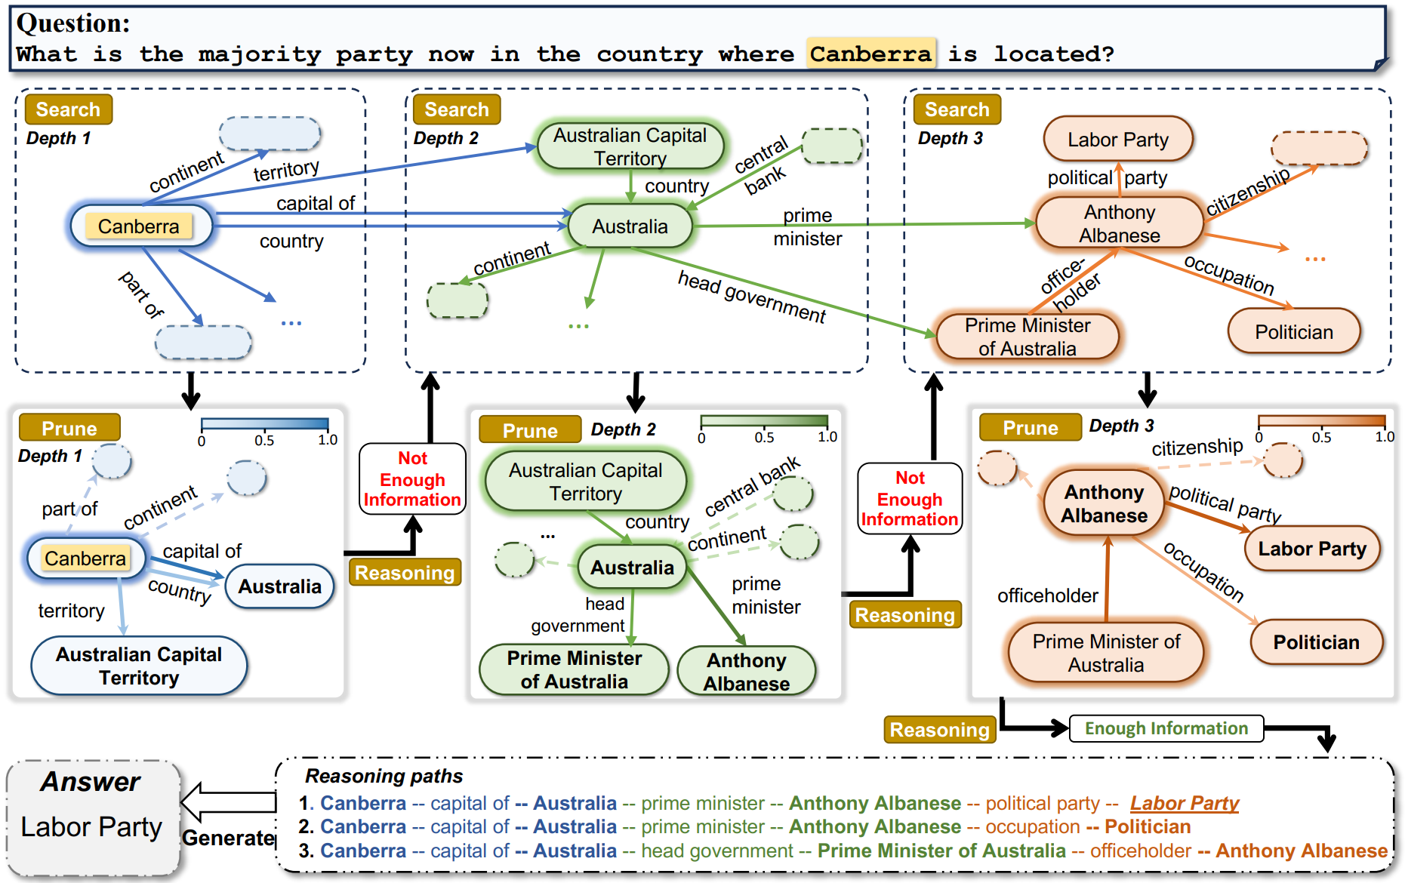
Think-on-Graph: Deep and Responsible Reasoning of Large Language Model on Knowledge Graph
Example:
1
2
3
[1] J. Sun, C. Xu, L. Tang, S. Wang, C. Lin. 2024. Think-on-Graph: Deep and Responsible Reasoning of Large Language Model on Knowledge Graph (ICLR 24).

Slide 30
Think-on-Graph: Deep and Responsible Reasoning of Large Language Model on Knowledge Graph
Example:
1
2
3
[1] J. Sun, C. Xu, L. Tang, S. Wang, C. Lin. 2024. Think-on-Graph: Deep and Responsible Reasoning of Large Language Model on Knowledge Graph (ICLR 24).

Slide 31
Think-on-Graph: Deep and Responsible Reasoning of Large Language Model on Knowledge Graph
Example:
1
2
3
[1] J. Sun, C. Xu, L. Tang, S. Wang, C. Lin. 2024. Think-on-Graph: Deep and Responsible Reasoning of Large Language Model on Knowledge Graph (ICLR 24).

Slide 32
Combining Knowledge Graph with LLMs
Categorization
LLMs enhance knowledge graph reasoning
Knowledge graph reasoning enhance LLMs
Integrating knowledge graph reasoning with LLMs in a mutually beneficial way
KG-enhanced LLMs
LLMs-augmented KGs
Synergized LLMs + KGs
[1] S. Pan, L. Luo,Y. Wang, C Chen. 2024. Unifying Large Language Models and Knowledge Graphs: A Roadmap (TKDE 24).

Slide 33
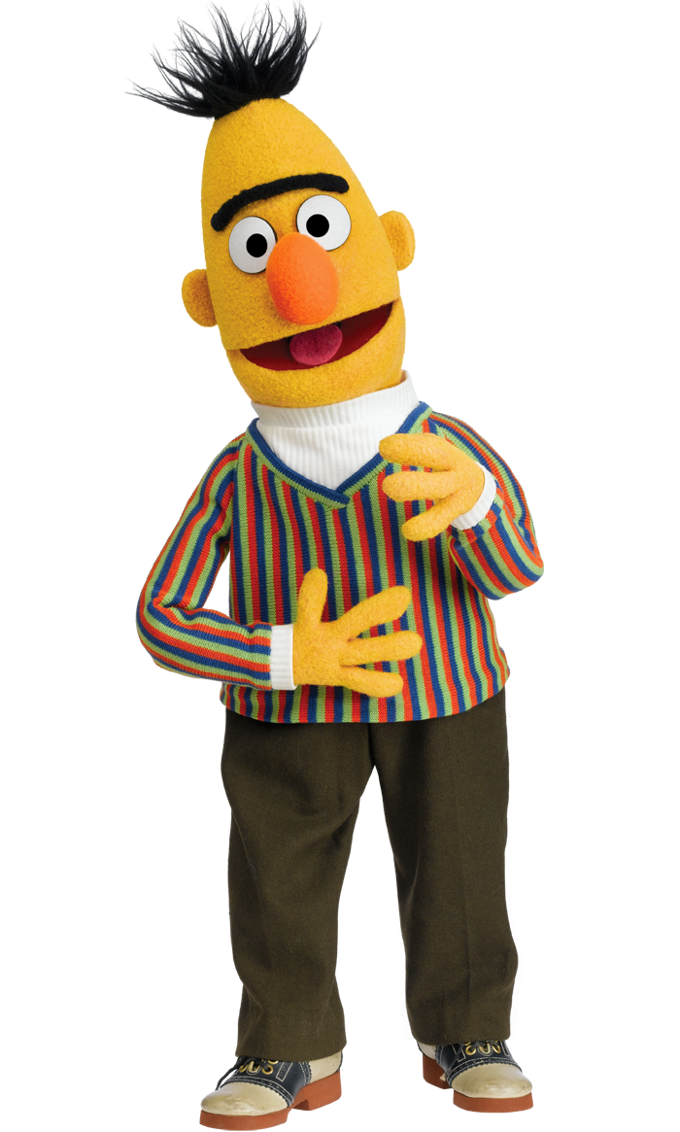
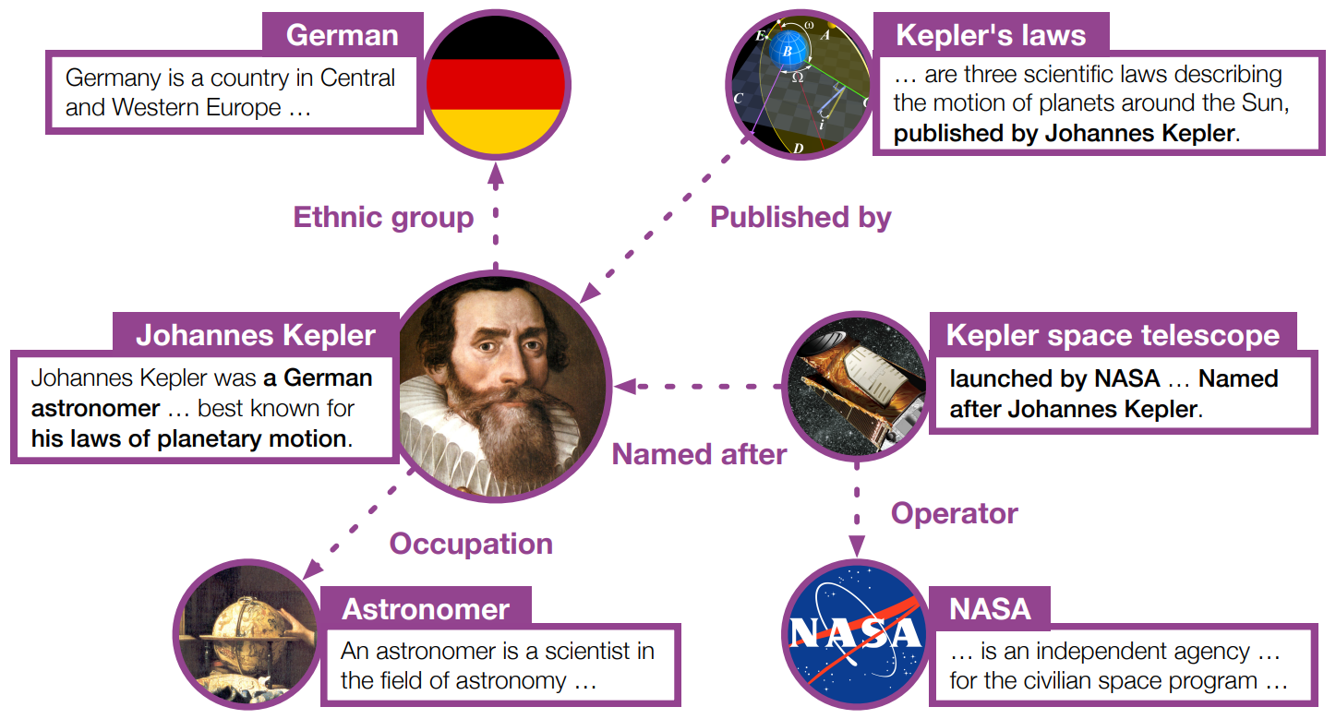
KEPLER: A Unified Model for Knowledge Embedding and Pre-trained Language Representation
Motivation:
Infuse world facts
Leverage textual information
do inductive KE
Knowledge graph embedding
Pre-trained Language Models
[1] X. Wang, T. Gao, Z. Zhu, Z. Zhang. 2021. KEPLER: A Unified Model for Knowledge Embedding and Pre-trained Language Representation (ACL 21).
Notes:
One of the most important tasks in knowledge graph reasoning is to learn the embedding for the KG entities. Some commonly used methods include TransE, TransH or graph neural networks and so on. It has been shown that the learned embedding from KG can be used to improve the performance of Pre-trained Language Models. On the other hand, for each node in the knowledge graph, we can find many text descriptions to describe it. This text information can be used to learn the node embedding. The strong ability of pre-trained language model can help us learn the embedding. So, in this paper, they propose a model which can also solve two problems at the same time.

Slide 34
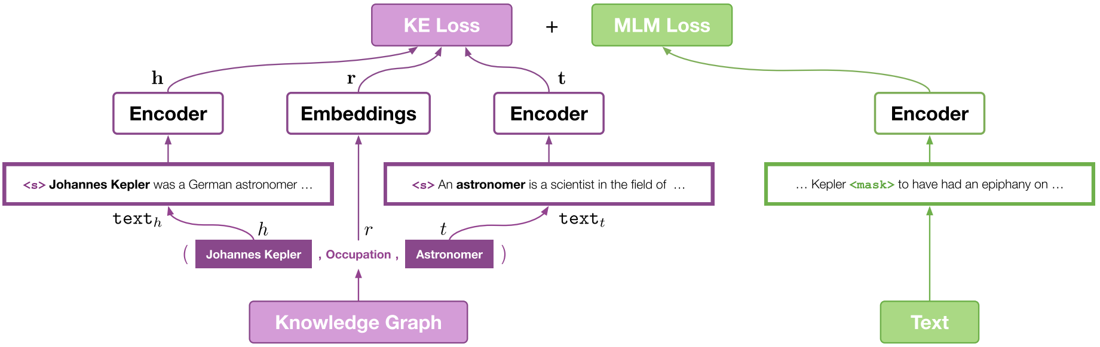
KEPLER: A Unified Model for Knowledge Embedding and Pre-trained Language Representation
Goal: joint optimizing knowledge graph embedding and masked language modeling (MLM) objectives
[1] X. Wang, T. Gao, Z. Zhu, Z. Zhang. 2021. KEPLER: A Unified Model for Knowledge Embedding and Pre-trained Language Representation (ACL 21).
Notes:
In this paper, Roberta is chosen as the encoder. Given a triplet, each node has a text description. Roberta is used to learn entity embedding. And the learned embedding will be used to calculate the knowledge graph embedding loss. On the other hand, conventional masked language model is used. It requires the model to predict the masked token within the text. The final loss is the summation of these two losses.

Slide 35
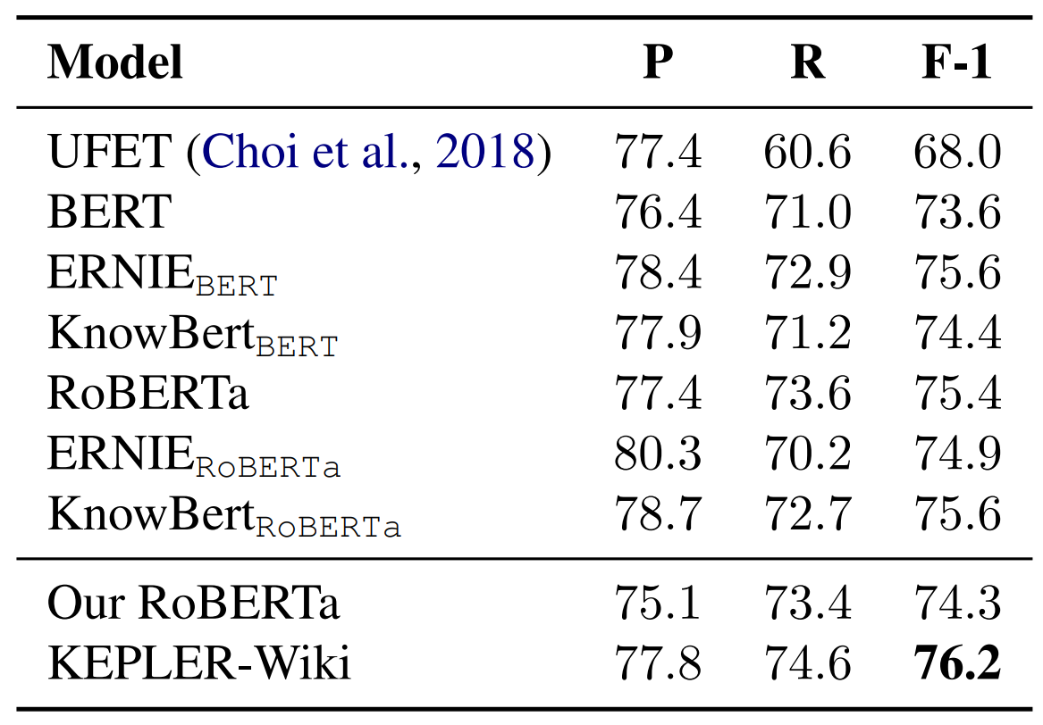
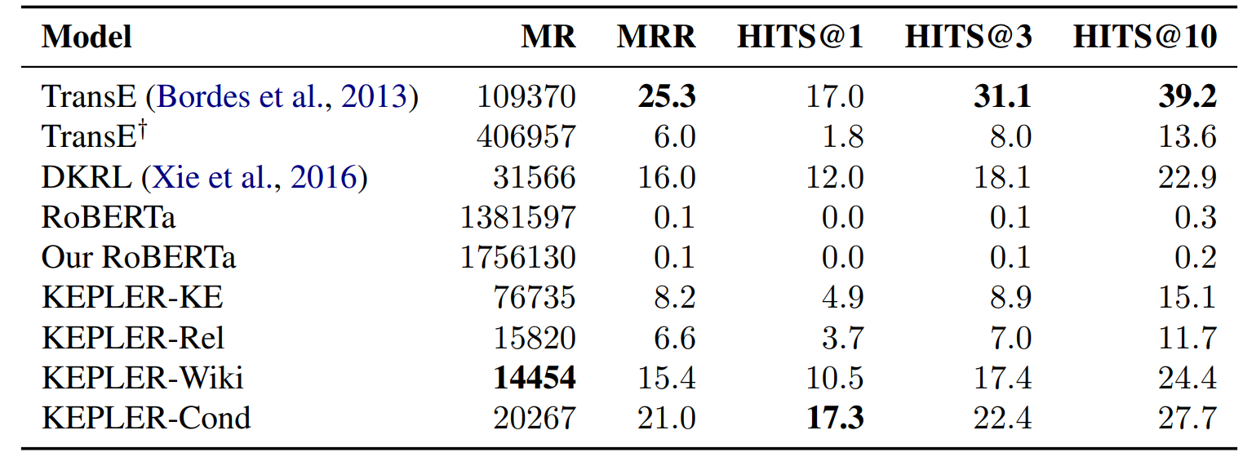
KEPLER: Experiments
Observations:
State of the art performance on KE task
State of the art performance on various NLP tasks
Performance on knowledge graph embedding task.
Entity typing results on OpenEntity (%)
[1] X. Wang, T. Gao, Z. Zhu, Z. Zhang. 2021. KEPLER: A Unified Model for Knowledge Embedding and Pre-trained Language Representation (ACL 21).

Slide 36
JAKET: Joint Pre-training of Knowledge Graph and Language Understanding
Goal: capture the knowledge graph structure information
TransE based method could not capture the structure information of KG
Idea: graph neural network
[1] D. Yu, C. Zhu, Y. Yang, M. Zeng. 2022. JAKET: Joint Pre-training of Knowledge Graph and Language Understanding (AAAI 22).

Slide 37
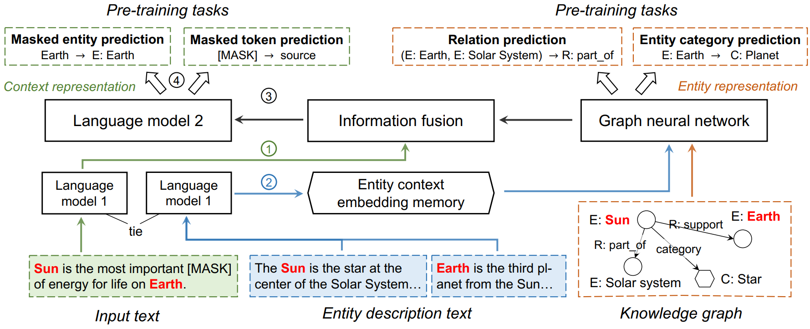
JAKET: Joint Pre-training of Knowledge Graph and Language Understanding
Goal: capture the knowledge graph structure information
[1] D. Yu, C. Zhu, Y. Yang, M. Zeng. 2022. JAKET: Joint Pre-training of Knowledge Graph and Language Understanding (AAAI 22).
Notes:
To leverage the structure information during the reasoning process, this work proposes to use a graph attention network to provide structure-aware entity embeddings for language modeling. More specifically, the language module produces contextual representations as initial embeddings for KG entities and relations given their descriptive text. Then, graph neural network is used to update the node embedding and relation embedding.

Slide 38
JAKET: Joint Pre-training of Knowledge Graph and Language Understanding
Advantages:
Eases the semantic matching between them
Solves the over-parameterization issue since entity embeddings are no longer part of the model’s parameters
[1] D. Yu, C. Zhu, Y. Yang, M. Zeng. 2022. JAKET: Joint Pre-training of Knowledge Graph and Language Understanding (AAAI 22).
Notes:
Next, the learned knowledge graph embedding will be used as the input of the language model. And the output of the language model will be used to solve different downstream tasks. There are several advantages of this method. On one hand, the joint pre-training effectively projects entities/relations and text into a shared semantic latent space, which eases the semantic matching between them. On the other hand, as the knowledge module produces representations from descriptive text, it solves the over-parameterization issue since entity embeddings are no longer part of the model’s parameters.

Slide 39
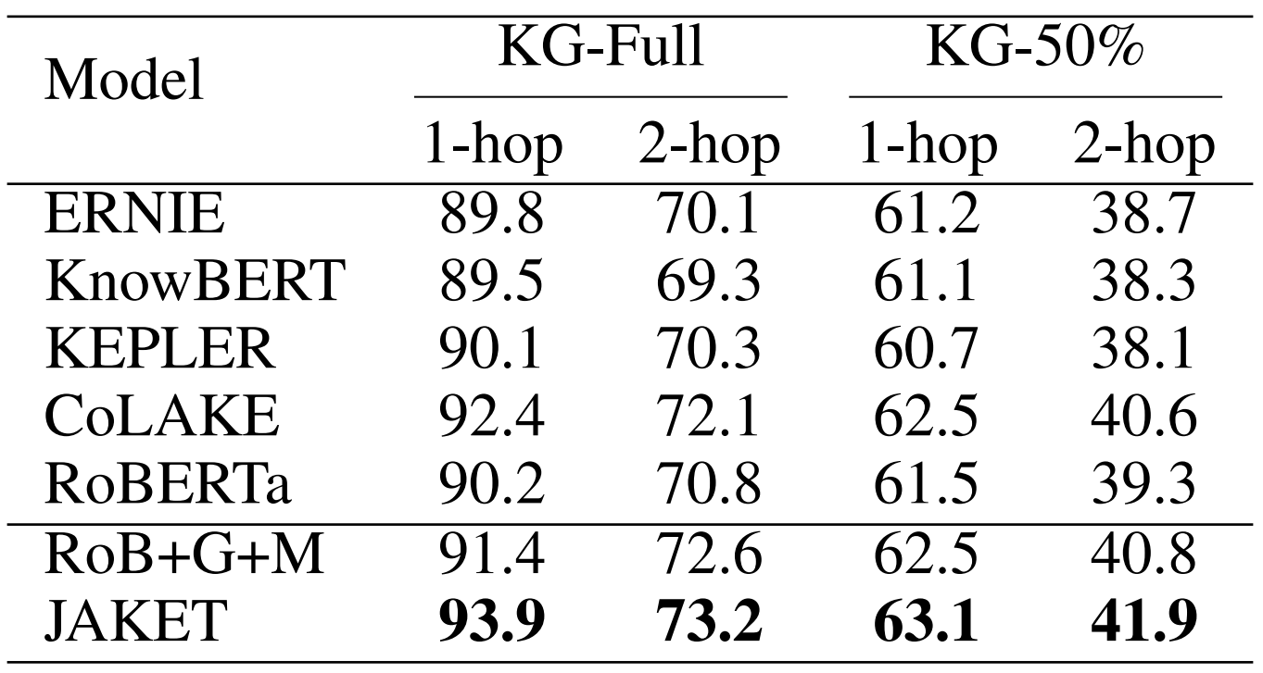
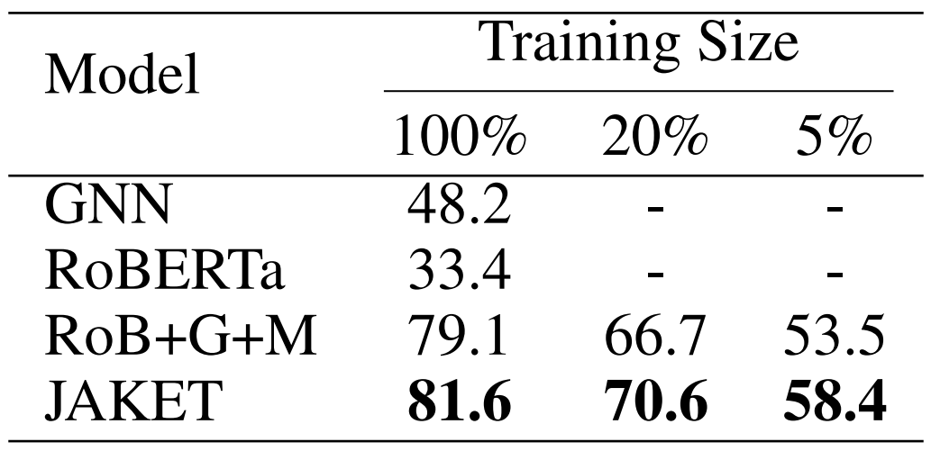
JAKET: Experiments
Observations:
State of the art performance on KE task
State of the art performance on various NLP tasks
Hits@1 results on the MetaQA dataset.
Accuracy results on the entity classification task.
[1] D. Yu, C. Zhu, Y. Yang, M. Zeng. 2022. JAKET: Joint Pre-training of Knowledge Graph and Language Understanding (AAAI 22).

Slide 40
Roadmap
Part I: Knowledge Graph Reasoning: Basic Concepts and Techniques
Part II: Recent Advance #1: Neural Reasoning for Natural Language Queries
Part III: Recent Advance #2: Neural Reasoning for Logical Queries
Part IV: Recent Advance #3: Neural Reasoning Beyond Entities and Relations
Part V: Recent Advance #4: LLM+KGR
Part VI: Open Challenges and Future Directions
Notes:
Today’s tutorial contains 4 parts.
At the beginning, I would like to give some background regarding the knowledge graph reasoning as well as the unique challenges behind this problem setting.
In part 1, we will introduce the details of general knowledge graph reasoning. and in part 2, we will introduce query specific knowledge graph reasoning. And finally, we will discuss the future trends for knowledge graph reasoning.

Slide 41
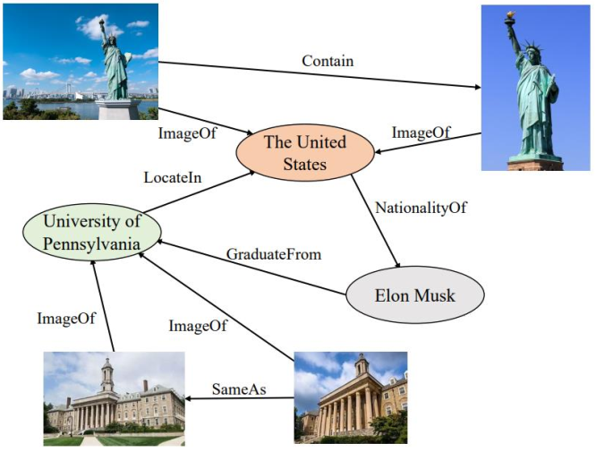
Future Direction #1: Multi-modal knowledge graph reasoning
Multi-modal knowledge graph reasoning: An emerging research area that combines structured knowledge graphs with unstructured data such as images, videos, audio, and other forms of sensory information.
Possible direction:
Knowledge graph reasoning for Visual and Textual Information
Notes:
The second future direction is reasoning on Multi-modal knowledge graph.
Multi-modal knowledge graph combines structured knowledge graphs with unstructured data such as images, videos, audio and so on.
Reasoning on Multi-modal knowledge graph can help use discovery some useful information, for example, it can used to predict whether two images contain the same building.

Slide 42
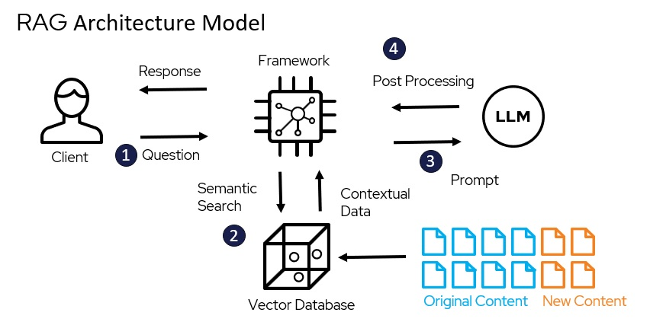
Future Direction #2: Retrieval-Augmented Multimodal Language Modeling
Retrieval augmented generation
An AI framework for improving the quality of LLM-generated responses by grounding the model on external sources
Mainly focuses on
Text data
Graph data
Possible direction:
Integrate other data types
Video, audio, image, spatial temporal data…
Notes:
The second future direction is reasoning on Multi-modal knowledge graph.
Multi-modal knowledge graph combines structured knowledge graphs with unstructured data such as images, videos, audio and so on.
Reasoning on Multi-modal knowledge graph can help use discovery some useful information, for example, it can used to predict whether two images contain the same building.

Slide 43
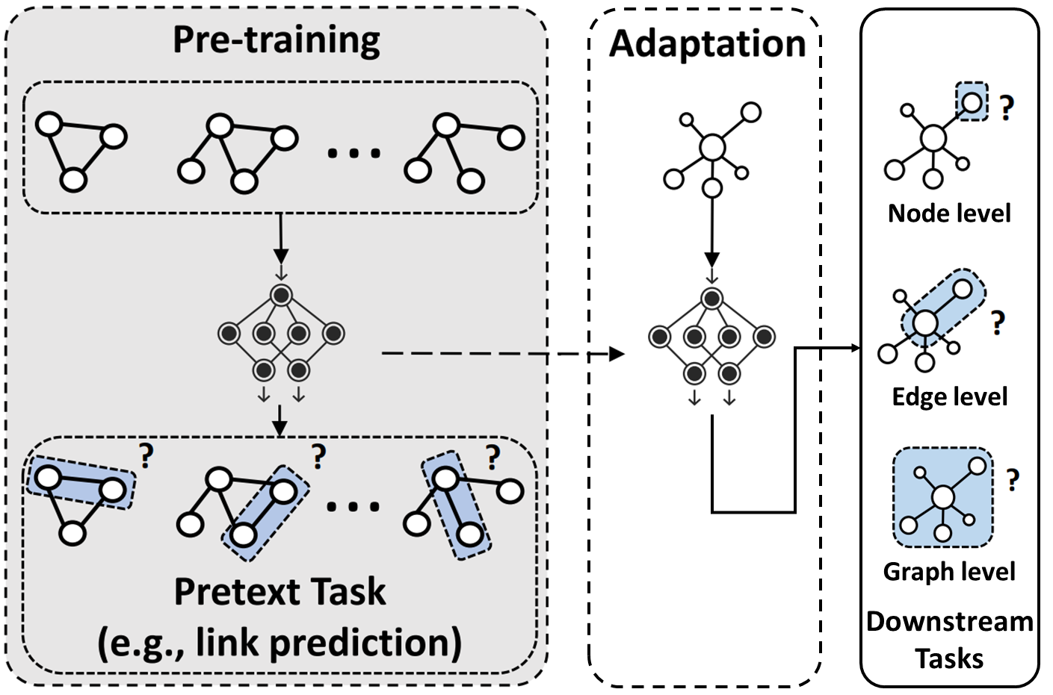
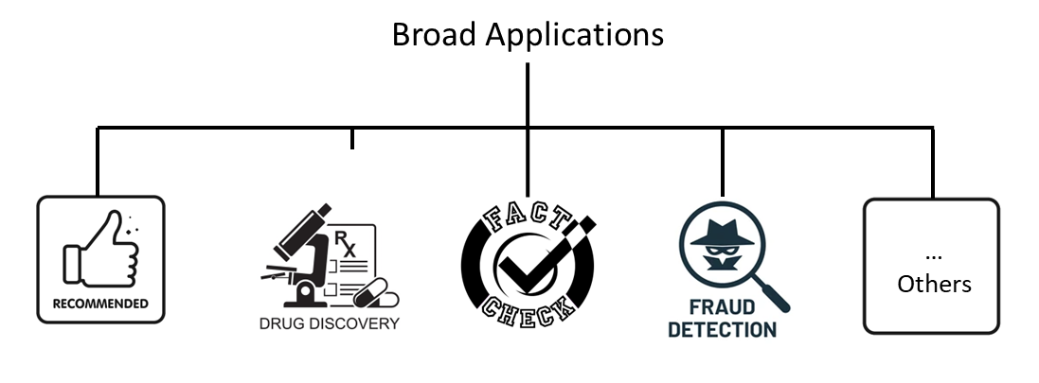
Future Direction #3 Knowledge Graph Foundation Models for Broad Applications
Knowledge graph reasoning plays a pivotal role in many high-impact applications
How to build a KG foundation model to solve multiple tasks?
Foundation model
Notes:
I further look forward to studying the application
However, current methods often focus on addressing a specific task within a single knowledge graph.
In our upcoming research, we aspire to explore the sharing of information among diverse tasks and the transfer of knowledge between different graphs.
Additionally, we aim to build foundation models or those large pretrained models for knowledge graphs, which can quickly adapt to different downstream tasks.

Slide 44
Summarization
New Frontiers of Knowledge Graph Reasoning
Neural Reasoning for Natural Language Questions
Neural Reasoning for Logical Queries
Neural Reasoning Beyond Entities and Relations
LLM+KGR
Notes:
In this part, I will introduce the General Knowledge Graph Reasoning from 4 categories, Knowledge Graph Embedding, xxxxx, path xxx, and xxx.
Now, let’s see the first category knowledge graph embedding.

Slide 45
Resources
Datasets: https://github.com/LIANGKE23/Awesome-Knowledge-Graph-Reasoning#datasets-
Code: https://github.com/uma-pi1/kge
Surveys:
J. Zhang, B. Chen, L. Zhang, X. Ke, H. Ding. Neural, symbolic and neural-symbolic reasoning on knowledge graphs. AI Open, 2021.
X Chen, S Jia, Y Xiang. A review: Knowledge reasoning over knowledge graph. Expert Systems with Applications, 2020.
K. Liang, L. Meng, M. Liu, Y. Liu, W. Tu, S. Wang, S. Zhou, X. Liu, F. Sun. A Survey of Knowledge Graph Reasoning on Graph Types: Static, Dynamic, and Multimodal. arXiv, 2023.
Related tutorials：
Reasoning on Knowledge Graphs: Symbolic or Neural?
https://aaai2022kgreasoning.github.io/
Rule Induction and Reasoning in Knowledge Graphs
https://www.youtube.com/watch?v=CanRy4NhMGQ
Notes:
The third future direction is reasoning on Cross-lingual knowledge graph reasoning.
Many knowledge graphs contain some similar pattern, despite they are described by different language.
Mining these patterns can help us find some useful information.
The possible direction includes Language-Agnostic Representation learning, Multilingual logical rule extraction, and Cross-Lingual Link Prediction

Slide 46
Acknowledgements
Part of the slides are credited to the following authors (in alphabetic order of last name)
Endri Kacupaj (Cerence)
Magdalena Kaiser (Max-Planck-Institut für Informatik)
Jure Leskovec (Stanford University)
Apoorv Saxena (Adobe)
Komal K. Teru (The Vanguard Group)
If you would like to re-use these slides, please contact the original authors
Notes:
The third future direction is reasoning on Cross-lingual knowledge graph reasoning.
Many knowledge graphs contain some similar pattern, despite they are described by different language.
Mining these patterns can help us find some useful information.
The possible direction includes Language-Agnostic Representation learning, Multilingual logical rule extraction, and Cross-Lingual Link Prediction

Slide 47
References
T. Trouillon, J. Welbl, S. Riedel, E. Gaussier, and G Bouchard. 2016. Complex Embeddings for Simple Link Prediction (ICML 16).
A. Bordes, N. Usunier, and A. Garcia-Duran. 2013. Translating Embeddings for Modeling Multi-relational Data (NeurIPS 13).
T. Dettmers, P. Minervini, P. Stenetorp, and S. Riedel. 2018. Convolutional 2D Knowledge Graph Embeddings (AAAI 18).
B. Yang, W. Yih, X. He, J. Gao, and L. Deng. 2015. Embedding Entities and Relations for Learning and Inference in Knowledge Bases (ICLR 15).
Z. Sun, Z. Deng, J. Nie, and J. Tang. 2019. RotatE: Knowledge Graph Embedding by Relational Rotation in Complex Space (ICLR 19).
M. Richardson, and P. Domingos. 2006. Markov Logic Networks (Machine learning 16).
W. Cohen. 2016. TensorLog: A Differentiable Deductive Database (arXiv 16).
N. Lao, T. Mitchell, and W. Cohen. 2011. Random walk inference and learning in a large scale knowledge base (ACL 11).
H. Wang, H. Ren, and J. Leskovec. 2021. Relational message passing for knowledge graph completion (KDD 21).
Notes:
This is the paper list of my phd program.

Slide 48
References
W. Xiong, T. Hoang, and WY. Wang. 2017. Deeppath: A reinforcement learning method for knowledge graph reasoning (ACL 17).
H. Wang, H. Ren, and J. Leskovec. 2021. Relational message passing for knowledge graph completion (KDD 21).
F. Yang, Z. Yang, W. Cohen. 2017. Differentiable Learning of Logical Rules for Knowledge Base Reasoning (NeurIPS 17).
K. Teru, E. Denis, W.L. Hamilton. 2020. Inductive Relation Prediction by Subgraph Reasoning (ICML 20).
B. Antoine, U. Nicolas, G. Alberto, W Jason, and Y. Oksana. 2013. Translating Embeddings for Modeling Multi-relational Data (NIPS 13).
S. Hu, L. Zou, J. X. Yu, H. Wang, and D. Zhao. 2018. Answering Natural Language Questions by Subgraph Matching over Knowledge Graphs (TKDE 18).
H. Ren, W. Hu and J. Leskovec. 2020. Query2box: Reasoning over Knowledge Graphs in Vector Space using Box Embeddings (ICLR 20).
J. Tang. 2022. Neural and Symbolic Logical Reasoning on Knowledge Graphs (AAAI 22).

Slide 49
References
L. Liu, B. Du, Y. Fung, H. Ji, J. Xu, and H. Tong. (2021). Kompare: A knowledge graph comparative reasoning system (KDD 21).
A. Saxena, A. Tripathi, P. Talukdar. 2020. Improving Multi-hop Question Answering over Knowledge Graphs using Knowledge Base Embeddings (ACL 20)
L. Liu, B. Du, J. Xu, Y. Xia, H. Tong. 2022. Joint Knowledge Graph Completion and Question Answering (KDD 22).
M. Kaiser, R. Saha Roy, and G. Weikum. 2021. Reinforcement Learning from Reformulations in Conversational Question Answering over Knowledge Graphs (SIGIR 21)
E. Kacupaj, K. Singh, M. Maleshkova, J. Lehmann. 2022. Contrastive Representation Learning for Conversational Question Answering over Knowledge Graphs (CIKM 22)
X. Lv, Y. Gu, X. Han, L. Hou, J. Li, Z. Liu. 2019. Adapting Meta Knowledge Graph Information for Multi-Hop Reasoning over Few-Shot Relations (EMNLP 19).
K. Huang, M. Zitnik. 2021. Graph Meta Learning via Local Subgraphs (NeurIPS 21).

